Slide 1


Sign Language Recognition
Shrilakshmi Pai Nallur
A20523709

Slide 2


Motivation
Communication with speech/hearing impaired individuals can be difficult for those who do not understand sign language. Sign language recognition technology can bridge this gap by translating sign language into spoken or written language in real-time. This technology improves the accessibility of information and services for deaf individuals in education, healthcare, and employment. Sign language recognition technology enhances the quality of life and social inclusion of deaf individuals, reducing the barriers they face in everyday life.

Slide 3
What is Sign Language?
Sign language is a visual language that uses hand gestures, facial expressions, and body movements to convey meaning. Many speech/ hearing impaired individuals use sign language as their primary means of communication.

Slide 4
Data Collection
MediaPipe Holistics is a platform for end-to-end video understanding that enables developers to build, deploy, and scale video-based machine learning applications. It provides pre-built building blocks and pipelines for tasks such as object detection, face detection, and hand tracking, making it easy to create complex video-based applications.

Slide 5
Why Actions over Image?
Real-world applications: Action recognition has many real-world applications, such as surveillance, human-computer interaction, and sports analysis.
Richer information: Action recognition provides richer information about the context and intent of a person's actions, which can be valuable in applications such as video analysis and robotics.
Greater challenge: Action recognition is a more challenging task than image recognition, which makes it a more interesting and rewarding problem to solve for researchers and practitioners.

Slide 6
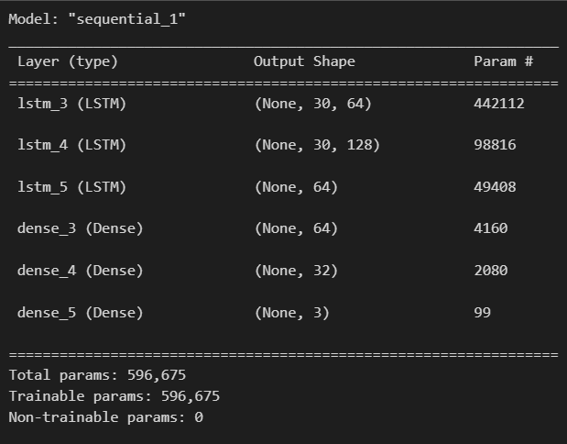
Why?
LSTM Model
LSTMs are a type of Recurrent Neural Network (RNN) that is capable of modeling long-term dependencies in sequential data. In sign language recognition, the input data would be a sequence of hand movements or gestures, which can be represented as a time series of feature vectors.
Capturing Long-Term Dependencies
Non-Linear Feature Extraction
Regularization

Slide 7
Evaluation using Confusion Matrix
Confusion matrix is used to evaluate the performance of a machine learning model in classification tasks. The confusion matrix is a table that summarizes the number of correct and incorrect predictions made by the model for each class.
Accuracy of 80%

Slide 8
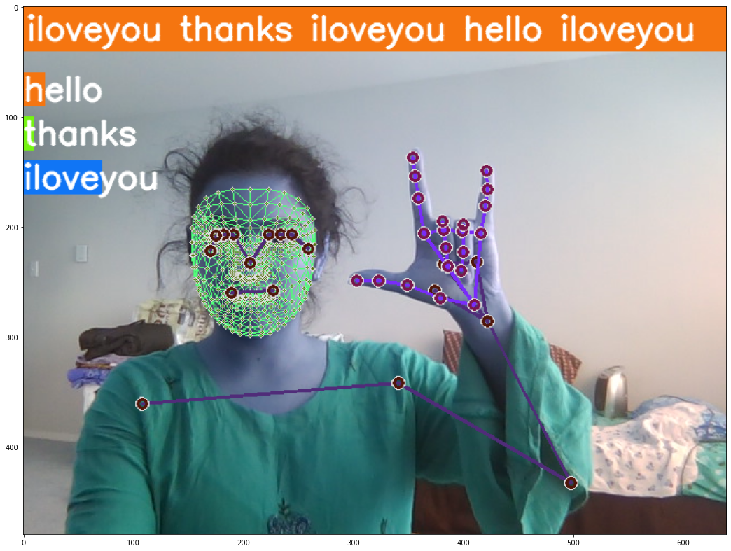
Prediction

Slide 9
Future Scope
Sentence Recognition
Increase the training dataset
Tune the Model for higher accuracy

Slide 10
Thank you

